Slide 1
F. Y. BCA
Subject – Web Development Using PHP
Chapter 4 – Arrays
Dr. Savita Mohurle

Slide 2
var_dump() syntax: var_dump(variable_name)
Is used to dump information about variables. That is display structure information such as type and value of given variable.
<?php
$array = array(
"a",
5=> "b",
7 => "c",
"d",
);
var_dump($array);
?>
Output:
D:\Wamp\www\array2.php:8:
array (size=4)
0 => string 'a' (length=1)
5 => string 'b' (length=1)
7 => string 'c' (length=1)
8 => string 'd' (length=1)

Slide 3
array_merge()
Merge list of array. It can take many parameters, merge it all
and returns back.
syntax: array_merge(array1,array2,…);
<?php
$a=array('a','b','c');
$b=array('d','e','f');
$c=array('g','h','i','j');
$m=array_merge($a,$b,$c);
print_r($m);
?>
Output : Array ( [0] => a [1] => b [2] => c [3] => d [4] => e [5] => f [6] => g [7] => h [8] => i [9] => i )

Slide 4
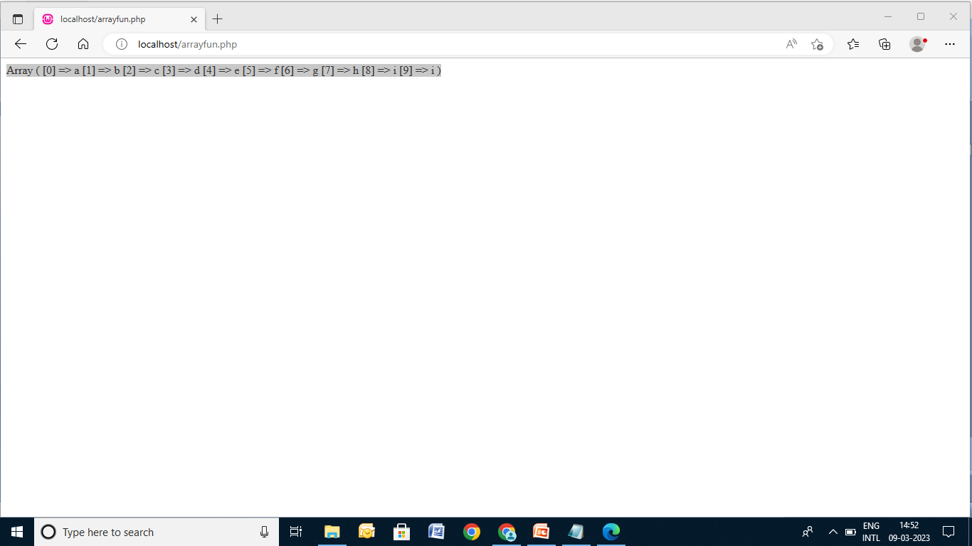

Slide 5
array_diff()
Common elements are excluded from another array. This is perfect function.
syntax: array_diff(array1,array2);
<?php
$a=array('a','b','c','g','h');
$b=array('a','b','f');
$m=array_diff($a,$b);
print_r($m);
?>
Output:
Array ( [2] => c [3] => g [4] => h )

Slide 6
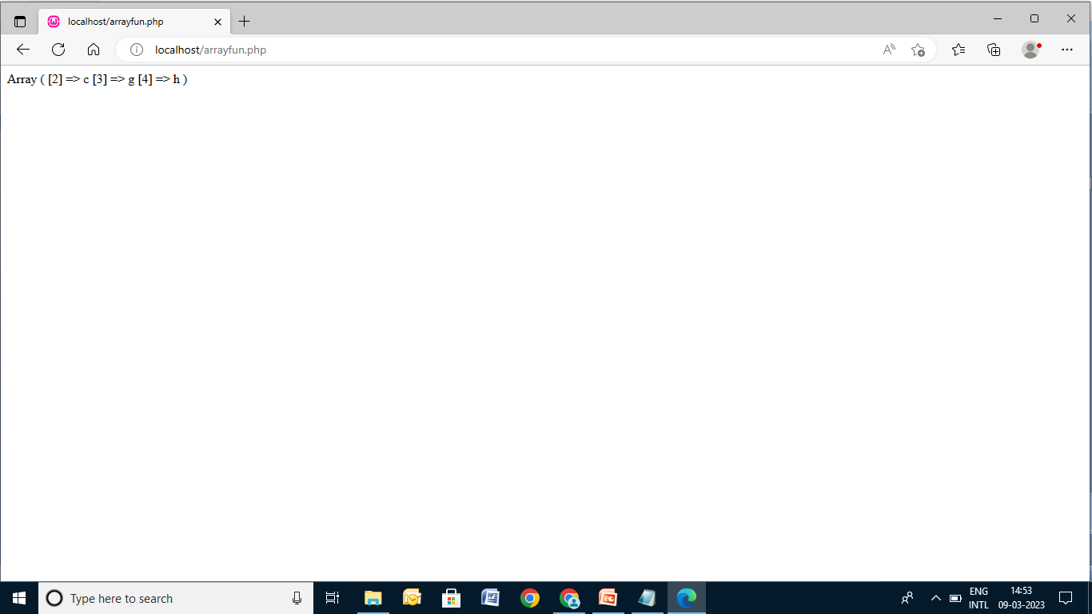

Slide 7
array_intersect()
Is the function that gets only common elements from two different arrays.
syntax: array_intersect(array1,array2);
<?php
$a=array('a','b','c','g','h');
$b=array('d','b', 'a','i','j');
$m=array_intersect($a,$b);
print_r($m);
?>

Slide 8
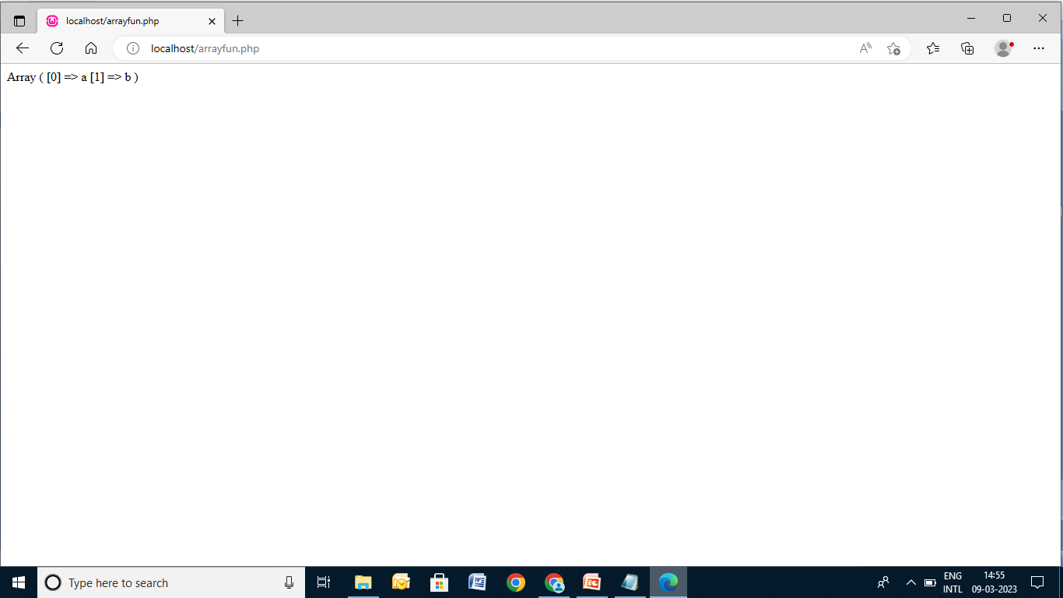

Slide 9
Associative array
Getting key and values of an associative arrays.
array_keys() & array_values()
syntax: array_keys(array_name);
<?php
$a=array("name1"=>"Savita", "name2"=>"Saksham","name3"=>"Snehal");
echo "\n ONLY KEYS: "."<br>";
print_r(array_keys($a));
echo "<br>"."\n ONLY VALUES: "."<br>";
print_r(array_values($a));
?>
ONLY KEYS: Array ( [0] => name1 [1] => name2 [2] => name3 ) ONLY VALUES: Array ( [0] => Savita [1] => Saksham [2] => Snehal )

Slide 10
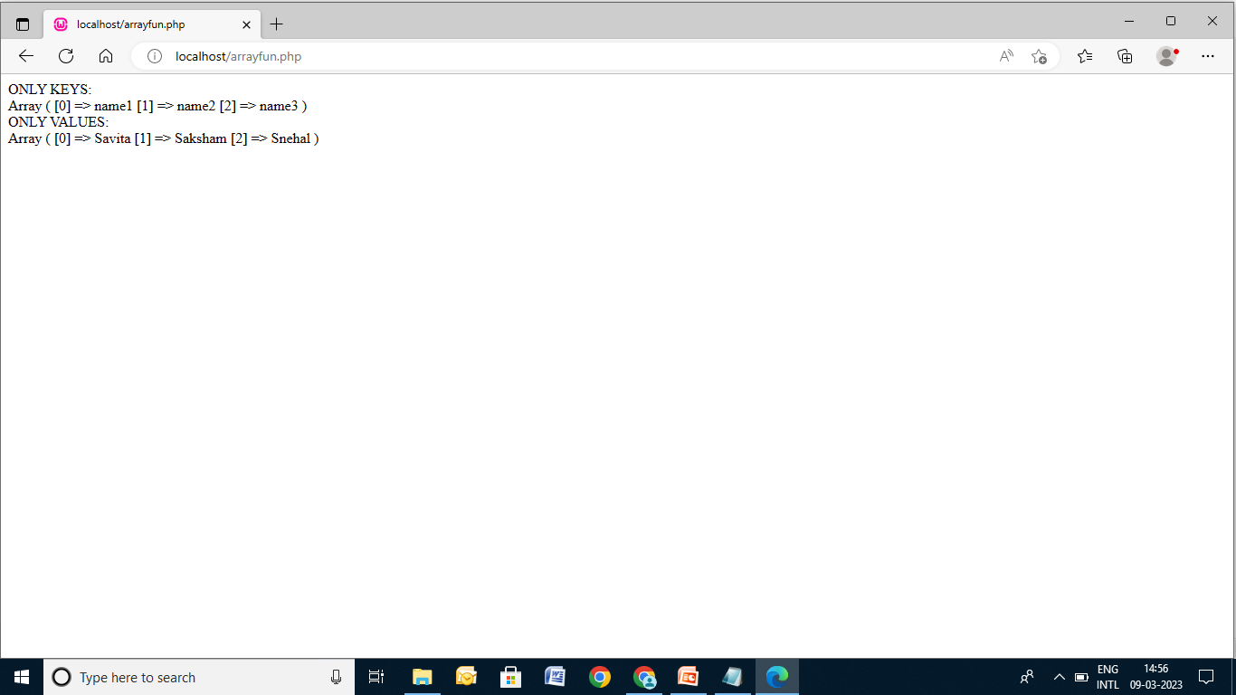

Slide 11
sort()
Will sort in simple default ascending order.
syntax: sort(array_name);
<?php
$a=array("name1"=>"Savita", "name2"=>"Saksham","name3"=>"Snehal");
sort($a);
print_r($a);
?> Output: Array ( [0] => Saksham [1] => Savita [2] => Snehal )
<?php
$a=array("abd", "abc","cnd","aaa","eee","ccc");
sort($a);
print_r($a);
?>
Output: Array ( [0] => aaa [1] => abc [2] => abd [3] => ccc [4] => cnd [5] => eee )

Slide 12
implode() & explode()
Convert array to string and string into array elements.
<?php
$a=array(1,2,-1,3,4,-5);
$s=implode(',',$a);
echo $s."<br>";
$v=explode(',',$s);
print_r($v);
?>
Output:
1,2,-1,3,4,-5
Array ( [0] => 1 [1] => 2 [2] => -1 [3] => 3 [4] => 4 [5] => -5 )
<?php
$a=array("abc","aaa","ddd","eee","fff");
$s=implode(',',$a);
echo $s."<br>";
$v=explode(',',$s);
print_r($v);
?>
Output:
abc,aaa,ddd,eee,fff
Array ( [0] => abc [1] => aaa [2] => ddd [3] => eee [4] => fff )

Slide 13
array_chunk()
Print part of array. Divide array into two.
syntax: array_chunk(array_name,size)
<?php
$a=array("abc","aaa","ddd","eee","fff","sss","hhh","kkk","nnn", "mmm");
$l=array_chunk($a,6);
print_r($l);
?>
<?php
$a=array(1,2,3,4,5,6,7,8,9,10,11,12,13,14,15);
$l=array_chunk($a,10);
print_r($l);
?>

Slide 14
Output:
Array ( [0] => Array ( [0] => abc [1] => aaa [2] => ddd [3] => eee [4] => fff [5] => sss ) [1] => Array ( [0] => hhh [1] => kkk [2] => nnn [3] => mmm ) )
Output:
Array ( [0] => Array ( [0] => 1 [1] => 2 [2] => 3 [3] => 4 [4] => 5 [5] => 6 [6] => 7 [7] => 8 [8] => 9 [9] => 10 ) [1] => Array ( [0] => 11 [1] => 12 [2] => 13 [3] => 14 [4] => 15 ) )

Slide 15
unset()
Delete element from an array.
<?php
$a=array(1,2,3,4,5,6,7,8,9,10,11,12,13,14,15);
var_dump($a);
unset($a[3]);
$x=array_values($a);
echo "<br>";
var_dump($a);
?>

Slide 16
Output of unset()
D:\Wamp\www\array2.php:3:
array (size=15)
0 => int 1
1 => int 2
2 => int 3
3 => int 4
4 => int 5
5 => int 6
6 => int 7
7 => int 8
8 => int 9
9 => int 10
10 => int 11
11 => int 12
12 => int 13
13 => int 14
14 => int 15
D:\Wamp\www\array2.php:7:
array (size=14)
0 => int 1
1 => int 2
2 => int 3
4 => int 5
5 => int 6
6 => int 7
7 => int 8
8 => int 9
9 => int 10
10 => int 11
11 => int 12
12 => int 13
13 => int 14
14 => int 15

Slide 17
rsort() – sort array in reverse order
Write a PHP script to sort an array in reverse order(highest to lowest)
syntax: rsort(array_name);
<?php
$a=array(1,2,3,4,5,6,7,8,9,10,11,12,13,14,15);
rsort($a);
print_r($a);
?>
<?php
$a=array('a','b','c','d','e');
rsort($a);
print_r($a);
?>

Slide 18
Output (Reverse Sort):
Array ( [0] => 15 [1] => 14 [2] => 13 [3] => 12 [4] => 11 [5] => 10 [6] => 9 [7] => 8 [8] => 7 [9] => 6 [10] => 5 [11] => 4 [12] => 3 [13] => 2 [14] => 1 )
Output (Reverse Sort):
Array ( [0] => e [1] => d [2] => c [3] => b [4] => a )

Slide 19
range()
Creates an array of consecutive integers or characters between two values that we pass to it as a parameter.
Syntax: range($start, $end [,$step=1]);
Example:
<?php
$a=range(0,5);
print_r($a);
?>
Output:
Array ( [0] => 0 [1] => 1 [2] => 2 [3] => 3 [4] => 4 [5] => 5 )
<?php
$a=range(0,50,10);
print_r($a);
?>
Output:
Array ( [0] => 0 [1] => 10 [2] => 20 [3] => 30 [4] => 40 [5] => 50 )

Slide 20
array_count_values()
Count values in an array.
<?php
$a=array('math',20,30,20,'Math','Science','Geography',
'English','English',20);
print_r(array_count_values($a));
?>
Output:
Array ( [math] => 1 [20] => 3 [30] => 1 [Math] => 1 [Science] => 1 [Geography] => 1 [English] => 2 )

Slide 21
count()
Return number of elements in array.
Syntax: count(array_name,mode);
Example:
<?php
$a=array('math',20,30,20,'Math','Science','Geography',
'English','English',20);
count($a);
echo count($a);
?>
Output:
10

Slide 22
sizeof()
Return number of elements in array.
Syntax: sizeof(array_name);
Example:
<?php
$a=array('math',20,30,20,'Math','Science','Geography',
'English','English',20);
echo sizeof($a);
?>
Output:
10

Slide 23
array_pad()
Pad an array to the specified length with a value.
Syntax: array_pad(input_array,pad_size,pad_value);
Example:
<?php
$a=array(1,2,3);
$p=array_pad($a,5,0);
print_r($p);
?>
<?php
$a=array(1,2,3);
$p=array_pad($a,-5,0);
print_r($p);
?>
<?php
$a=array('a'=>"Rohan","b"=>"Rahul","c"=>"Rohit");
$p=array_pad($a,7,"yyy");
print_r($p);
?>

Slide 24
Output (Blue):
Array ( [0] => 1 [1] => 2 [2] => 3 [3] => 0 [4] => 0 )
Output (Pink):
Array ( [0] => 0 [1] => 0 [2] => 1 [3] => 2 [4] => 3 )
Output (Purple):
Array ( [a] => Rohan [b] => Rahul [c] => Rohit [0] => yyy [1] => yyy [2] => yyy [3] => yyy )

Slide 25
array_slice()
Extract a slice of an array.
Syntax: array_slice(array_name,starting_point,slice_length,preserve_key);
Example:
<?php
$a=array("aaa","bbb","ccc","ddd","eee","fff","ggg");
$p=array_slice($a,2,3);
print_r($p);
?>
<?php
$a=array("Rohan","Rahul","Rohit","Ravi");
$p=array_slice($a,1);
print_r($p);
?>

Slide 26
Output (Pink):
Array ( [0] => ccc [1] => ddd [2] => eee )
Output (Blue):
Array ( [0] => Rahul [1] => Rohit [2] => Ravi )

Slide 27
shuffle()
Randomized the order of elements in array. The function assigns new keys to elements in array.
Syntax: shuffle(array_name);
Example:
<?php
$a=array("Rohan","Rahul","Rohit","Ravi");
shuffle($a);
print_r($a);
?>
Output:
Array ( [0] => Ravi [1] => Rohit [2] => Rohan [3] => Rahul )
Array ( [0] => Rahul [1] => Rohan [2] => Ravi [3] => Rohit )

Slide 28
Viewing array structure and values
<?php
$a=array("Mumbai","Pune","Nagpur","Amravati");
print_r($a);
?>
<?php
$a=array("Mumbai","Pune","Nagpur","Amravati");
var_dump($a);
?>

Slide 29
key()
Returns key located at current pointer position of array.
Syntax: key(array_name)……..next(array_name);
Example:
<?php
$state=array("MH"=>"Maharashtra","KN"=>"Karnataka",
"OR"=>"Orrisa");
while($k=key($state))
{
echo $k."<br>";
next($state);
}
?>
Output:
MH KN OR

Slide 30
array_flip()
Exchange key value pair in associative values in an array.
Syntax : array_flip(array_name);
Example:
<?php
$state=array("MH"=>"Maharashtra",
"KN"=>"Karnataka", "OR"=>"Orrisa");
$s=array_flip($state);
print_r($s);
?>
Output:
Array ( [Maharashtra] => MH [Karnataka] => KN [Orrisa] => OR )

Slide 31
Example
Write PHP script to consider associative array. Implement following functions on array:
array_flip()
array_count_values()
array_keys()
array_values()
shuffle()
sort()

Slide 32
Thank You

